Slide 1

WORKSHOP RECAP
5-Day Gen AI Intensive
Mastering LLM Tools, AI-Driven Development, and Rapid Prototyping
Gemini CLI
Qodo
Mistral
Lovable

Slide 2
PART 01
The Gen AI Tech Stack
An exploration of the core tools used to streamline the development lifecycle from prompt to deployment.

Slide 3






Core Development Tools
Gemini CLI
Qodo AI
Mistral-Vibe
Direct terminal interface for interaction with Google's most capable models, enabling rapid scripting and workflow automation.
Advanced coding assistant focusing on code quality, automated testing, and intelligent refactoring within the IDE.
Leveraging high-efficiency Mistral models for fast, context-aware responses and intelligent data processing.

Slide 4




Prototyping & Infrastructure
Lovable AI
GitHub Mastery
A transformative full-stack AI builder that turns natural language prompts into functional, deployed web applications in minutes.
Essential version control integration, managing project branches, and facilitating collaborative AI-augmented development workflows.

Slide 5
5-Day Workshop Roadmap
Day 1
Day 2
Day 3
Day 4
Day 5
Tooling Setup & Environment Configuration
Gemini CLI & Prompt Engineering
Qodo: Quality & Logic Design
Mistral-Vibe Integration
Lovable Fullstack & Project Launch

Slide 6
PART 02
Applied Projects
Practical application of the toolstack to create high-quality, minimalistic web solutions.

Slide 7

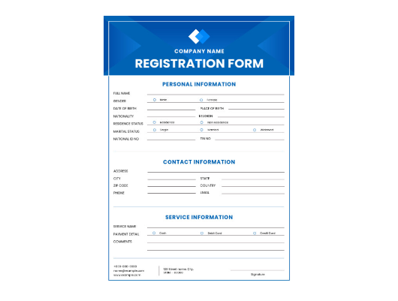
Project I: Student Bio Form
Automated Data Collection
Developed a clean, responsive HTML/CSS form designed for academic data capture.
Minimalistic UI following UX best practices
Client-side validation for data integrity
Accessible design for diverse users

Slide 8
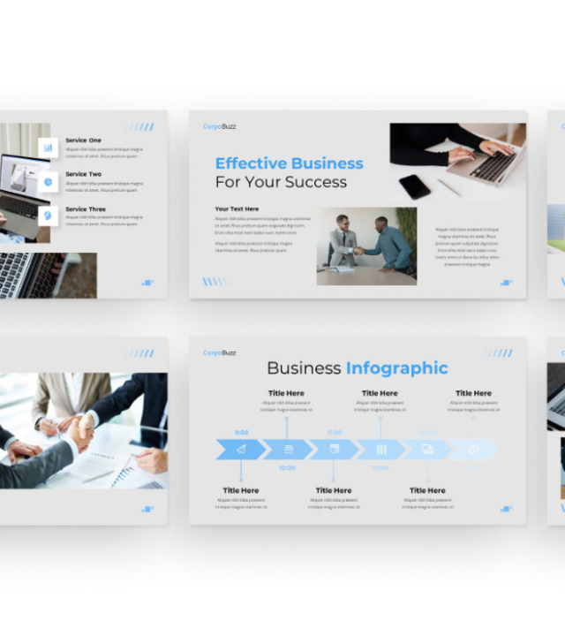
Project II: Business Site
Professional Web Presence
Created a comprehensive business landing page utilizing Lovable and AI-assisted design principles.
Modern hero sections and feature grids
Mobile-first responsive architecture
Optimized for conversion and speed

Slide 9
Learning Impact
05
02
Advanced Tools
Live Web Projects
100%
40h
AI Integration
Intensive Training

Slide 10
Core Competencies Developed
Prompt Engineering: Mastering context and constraints for LLMs.
Rapid Prototyping: From concept to deployment with Lovable.
AI Coding Workflow: Using assistants to increase velocity.
Version Control: Branch management and conflict resolution.

Slide 11
"
AI will not replace developers, but developers who use AI will replace those who do not.
— Industry Insight

Slide 12
Questions & Discussion
Exploring the future of AI-augmented development.
Thank You!
Session Recap Completed Successfully

Slide 13






Image Sources
https://storage.googleapis.com/aisuperhub.firebasestorage.app/blog-images/1760076359671-z6qrss.png
Source: www.aisuperhub.io
https://codium.gallerycdn.vsassets.io/extensions/codium/codium/1.7.15/1772124947274/Microsoft.VisualStudio.Services.Icons.Default
Source: marketplace.visualstudio.com
https://cdn.vectorstock.com/i/1000v/31/58/mistral-ai-logo-vector-50163158.jpg
Source: www.vectorstock.com
https://work-management.org/wp-content/uploads/2025/06/lovable-icon-bg-light.webp
Source: work-management.org
https://static.vecteezy.com/system/resources/thumbnails/040/963/221/small/github-logo-animated-opacity-free-video.jpg
Source: www.vecteezy.com
https://d1csarkz8obe9u.cloudfront.net/posterpreviews/blue-modern-registration-form-design-template-661d873e8bc3da99f2fab8b628f5a9a6_screen.jpg?ts=1733038225
Source: www.postermywall.com

Slide 14

Image Sources
https://nulivo.s3.us-east-2.amazonaws.com/media/users/digitcase/products/6105/screenshots/Template%202.jpg?v=1
Source: www.nulivo.com

